Slide 1

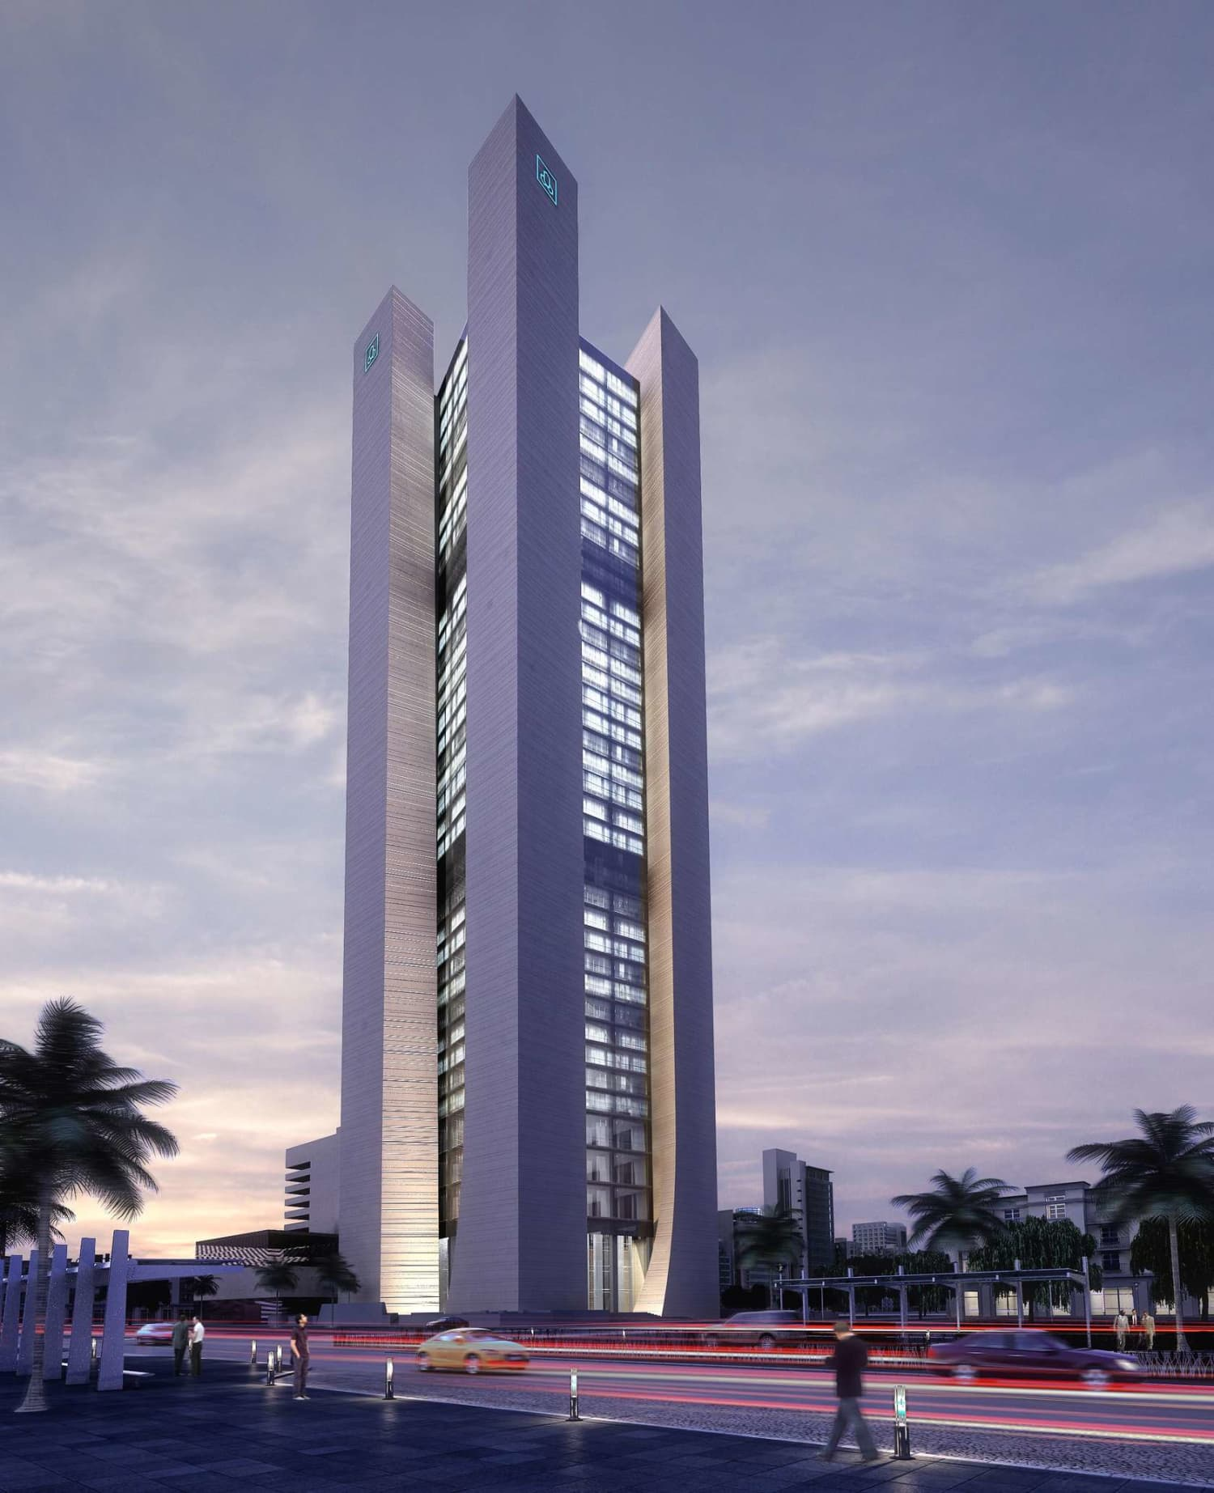
AL-Rajhi Bank Highrise Building

Slide 2
Project team members
1- Mshari Alqassem 437103836
2- Faisal Almahmood 437104470
3- Fahad Alofani 437104121
4- Asim Alalawla 435102147

Slide 3
Table of content
Topic | Page
Introduction | 4
Methodology | 5
Project Initiation | 6-12
Project Planning | 13-19
Project Executing | 20-23
Project Monitoring and Controlling | 24-28
Project Closing | 29-30
Challenges | 31
Summary | 32

Slide 4
Introduction
Al-Rajhi bank Is the largest Islamic bank in the world occupying. domestic and international presence “Jordan, Malaysia, Kuwait”.
Al-Rajhi building tower started from 2012 and completed by 2018.
The building has 36 stories with 2 mechanical floors, and it is located in Riyadh, king Fahad road.
The tower has a wellness center for the employs as well as a complete floor for catering services.

Slide 5
Which methodology did they use?
They used Waterfall methodology from 2012 – 2015.
2015 – 2018 they shifted to Agile methodology.
Why did they change it ?
- They change because there are new stakeholders such as CFO.
they wanted a new requirements for their department this delayed the project therefor they change to agile.

Slide 6
Project Initiation(Scope,time,cost)
The scope is: Tower of 36 stories, car parking building of eleven stories and 4 basements.
Time: Originally by contract 3 years.
Cost: Over 500 million SR.

Slide 7
Reasons for delaying the project
Financial delay: Cash flow was not easy to confirm, it takes time.
Material delivery delay: broken material , quantity was less than the agreement.
Corruption: Some contractors sign for high quality materials but brings low quality.
- Consultant: The consultant was fired because he delayed the project on purpose to get more money. The new consultant needed time to learn about the project.
Lack of communication with departments: Departments take a lot of time to answer the requests.

Slide 8
How did they face it
Bank revenue: They used bank revenue to fund the project.
Minutes of meetings: Formal meeting were they sign on an agreement to when a certain task will be finished.
Communication: informal (please sign it now).

Slide 9
Project Initiation
Who’s the project sponsor ?
Al-Rajhi executive board.
Who’s the project manager?
Eng. Fahmy fahim.
A business case: N/A.

Slide 10
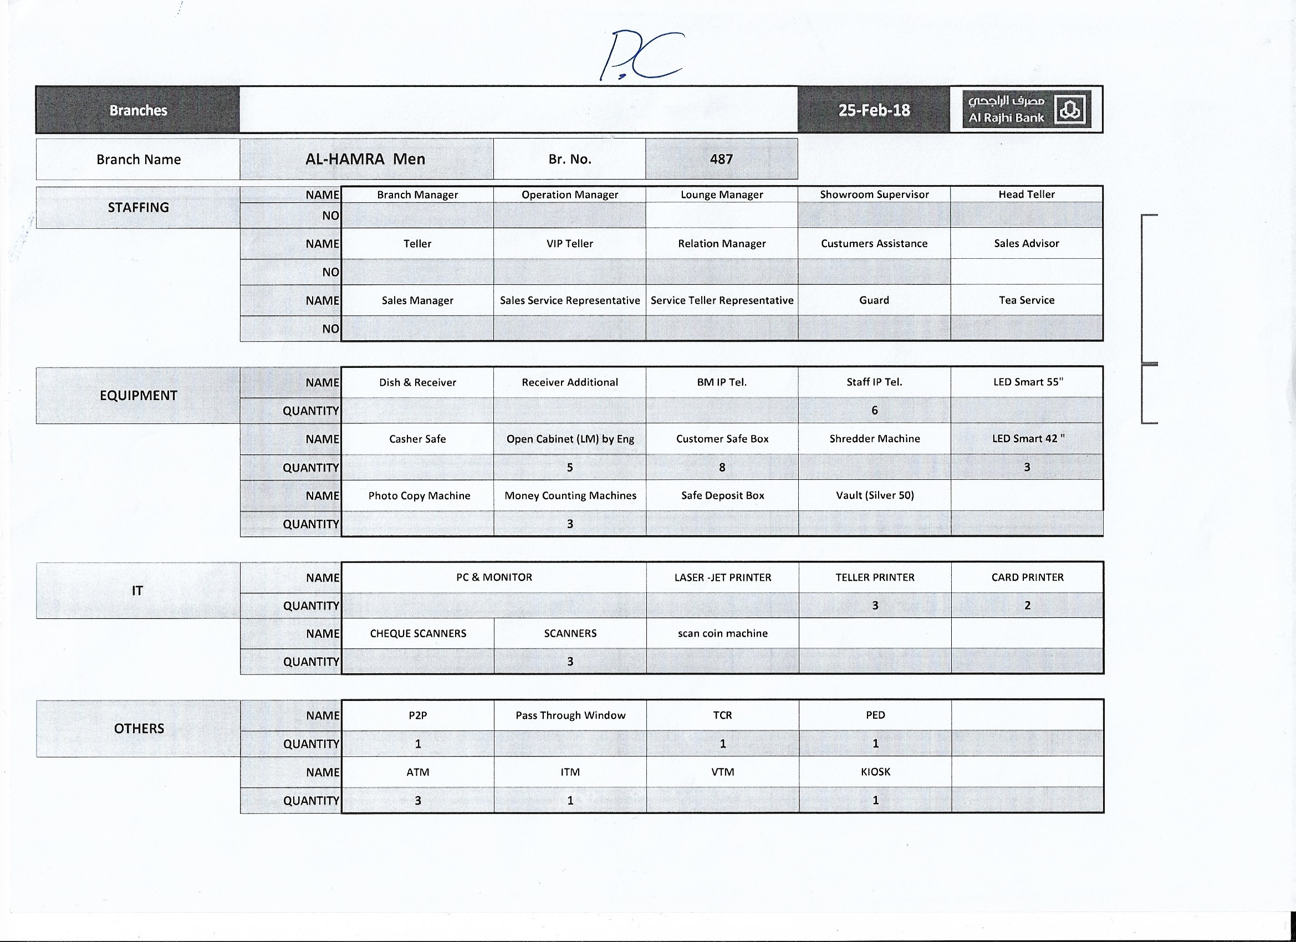


Project initiation (Project Charter)
Project charter

Slide 11

Project initiation (integration Management)
Project charter

Slide 12
Project initiation (stakeholders register)
Name | position | Internal/external | Project role | Contact info
Abdullah Alrajhi | Chairman | Internal | Sponsor | NA
Steve B | CEO | Internal | Main Stockholder | NA
Waleed | COO | Internal | stakeholder | NA
Fahmi Fahim | GM | Internal | PM | NA

Slide 13
Project planning (project scope statement)
To build a new headquarter for al-rajhi bank in Riyadh on king Fahad road.
Provide a new work environment for employee.
Include Entertainment facilities , Health center
Provide elevators for all employees to control crowding.
Parking for employees and visitors

Slide 14
Project planning (WBS)

Slide 15
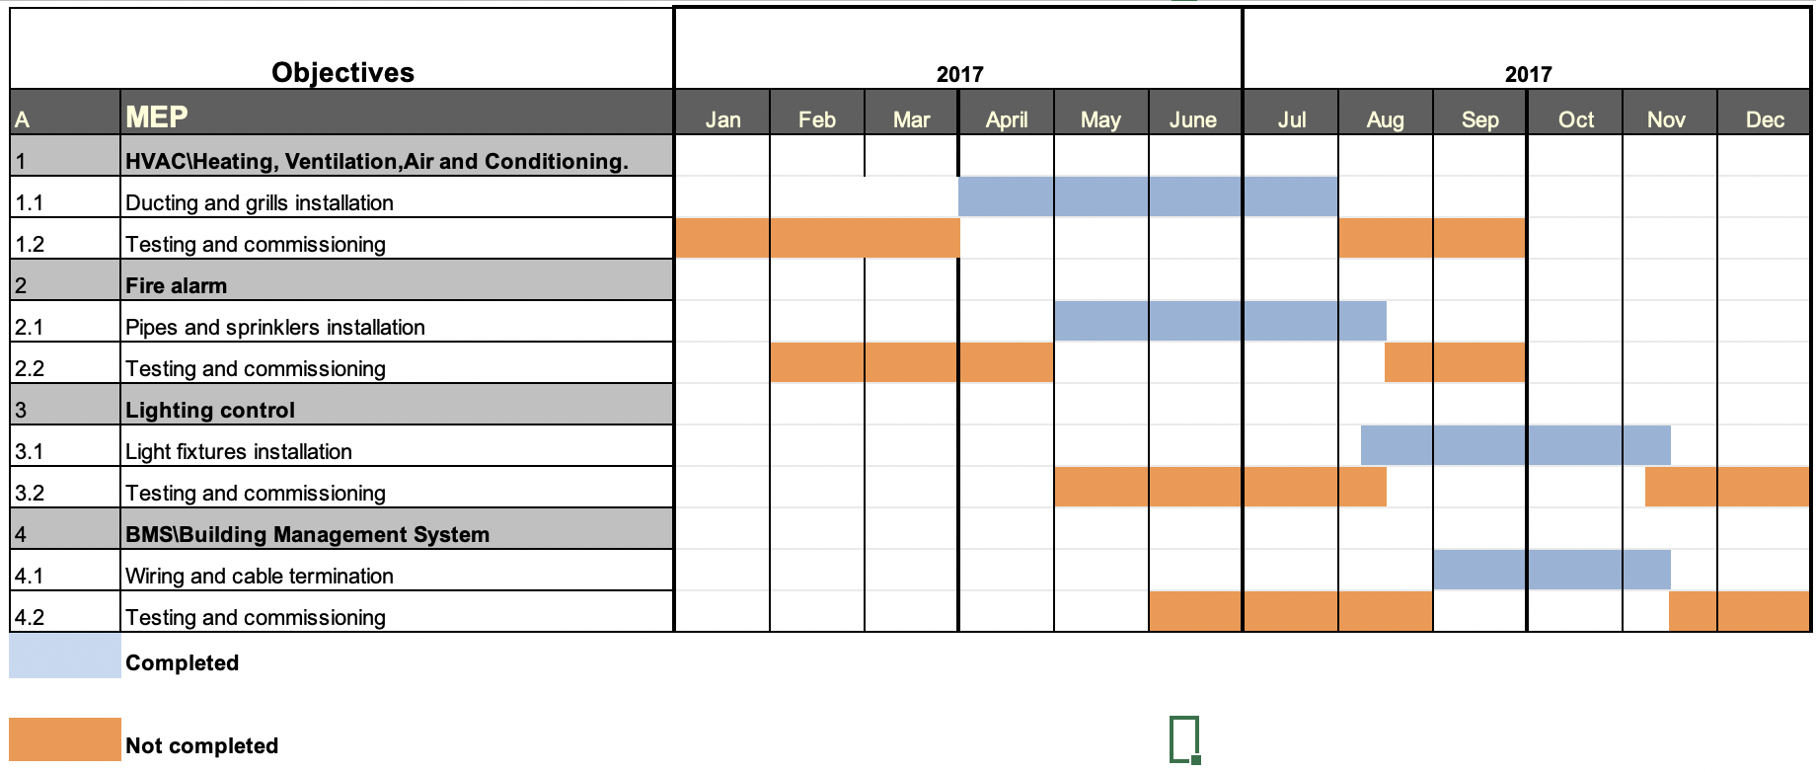
Project planning (Gantt Chart)

Slide 16
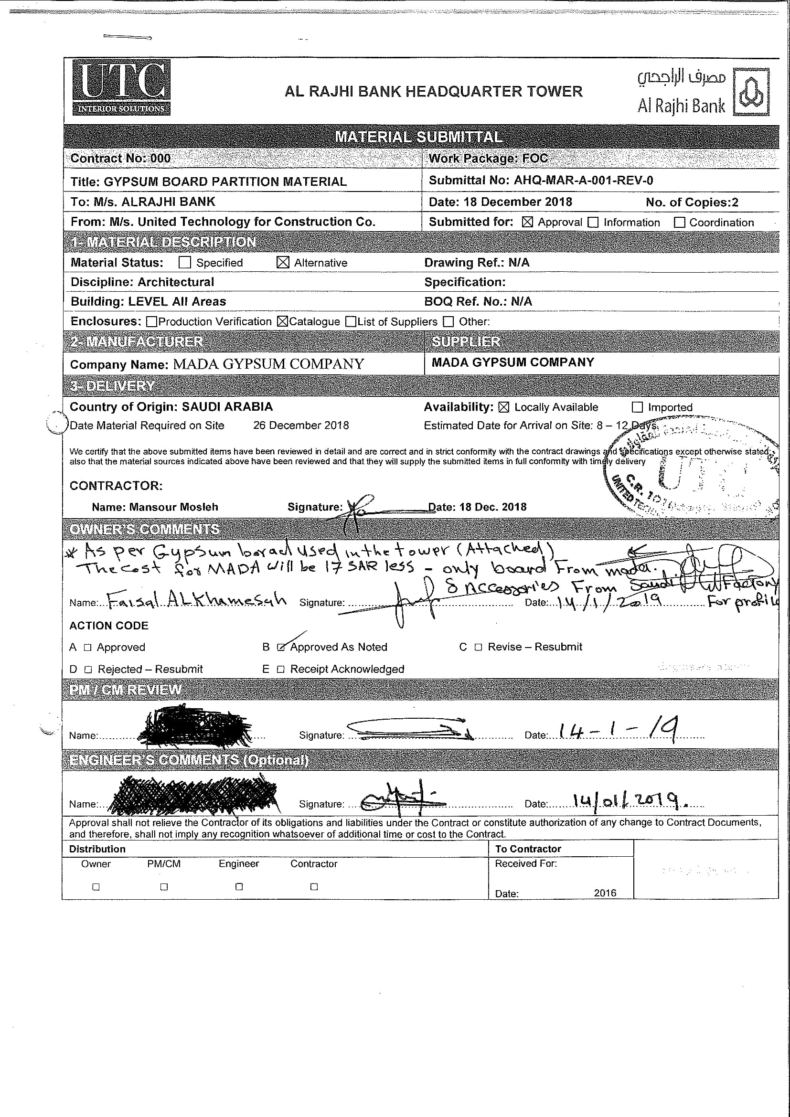
Project planning (material submittal)

Slide 17
Project planning (material submittal)

Slide 18
Project planning (material submittal)

Slide 19
Project planning (Risk register)
Ranking | Potential Risk
1 | Security
2 | Information security
3 | Safety measurement
4 | Financial
5 | Materials

Slide 20
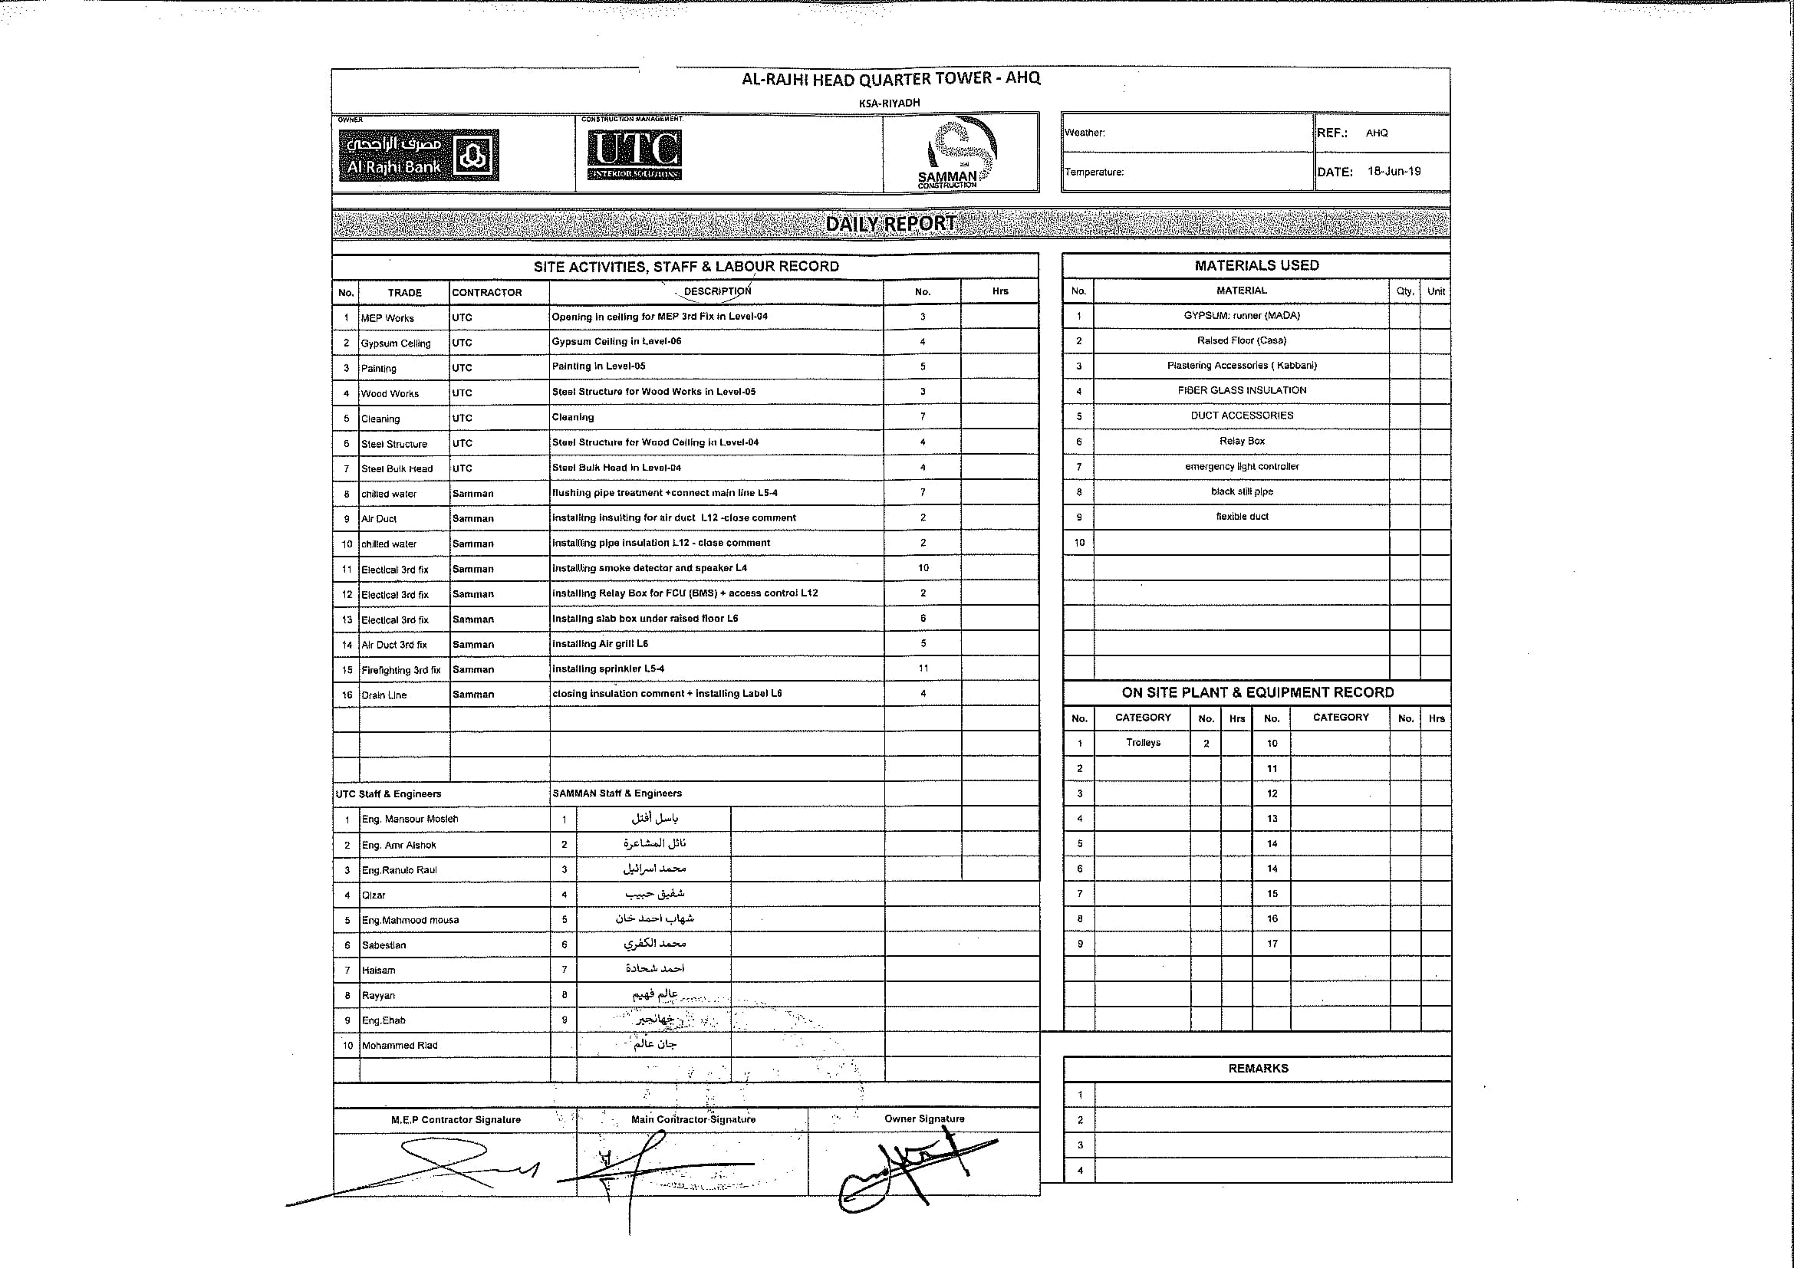
Project executing (execution process)

Slide 21
Project executing (execution process)

Slide 22
Project executing (execution process)

Slide 23
Project executing (execution process)

Slide 24
Project Monitoring and Controlling
Performance reports (metrics): N/A.
Update previous plans :N/A.
Change request.

Slide 25
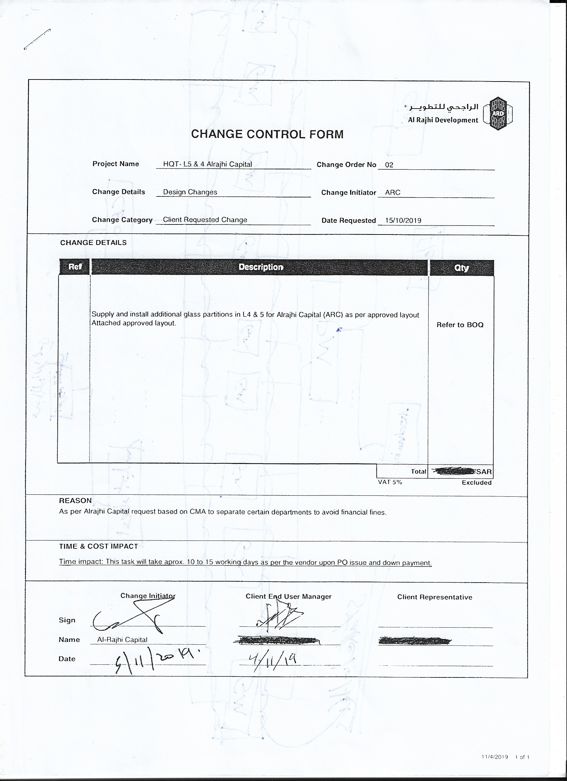
Change Request

Slide 26
Change Request

Slide 29
Project closing
Final report: with consultant / confidential
Sponsor / stakeholder presentation: physical on site presentation.
Lesson learned:
-Having one main contractor, having single point of contact to avoid corruption.
-Ensuring materials country of origin.
-Constant communication with departments, main coordinator to improve the work.

Slide 30
Project closing (cont.)
-Involve stockholders of any changes.
-Always Pay for quality, one time they didn’t pay for the quality and they regret it.
-Facility management team from the beginning of the project.

Slide 31
Challenges
1-Working at Ramadan.
Working during fasting hours is hard and too long for workers, So they decided to bring non-Muslims workers to work.
2-Working at night requires high electricity.
They decided to let the works that do not require high electricity at the night such as loading materials to high floor.
3-Worker do not follow safety instruction.
Some workers did not care about safety, so the PMO decided to impose penalty for those who didn’t follow the instruction.

Slide 32
Summary
The largest Islamic bank in the world.
They used two methodologies.
the scope is to build 36 stories.
Corruption plays a major role in delaying the project.
Every project have lesson learned and they have to learn from it.

Slide 33
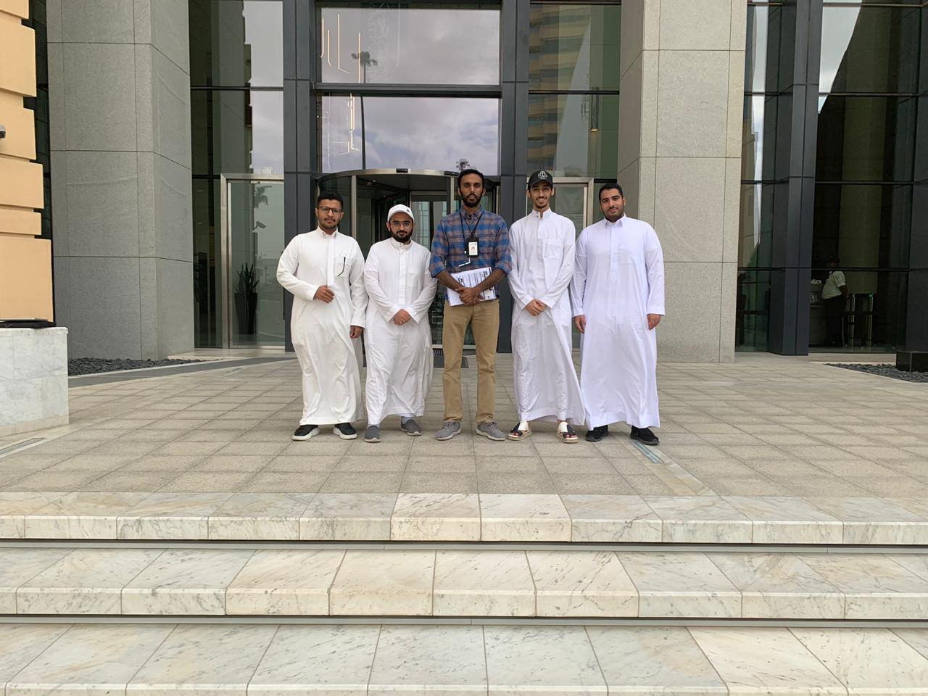
Thanks for the listening
Any Questions ?

